Slide 1
Ecommerce problem - Mobile App or Website
Problem statement -
Ecommerce company based in New York City that sells clothing online but they also have in-store style and clothing advice sessions. Customers come in to the store, have sessions/meetings with a personal stylist, then they can go home and order either on a mobile app or website for the clothes they want. The company is trying to decide whether to focus their efforts/expenses on their mobile app experience or their website.

Slide 2
We did confirm first that there is no need for Data Wrangling as the data is pretty much clean also there are no null values to clean .
Out of all the columns we decided to go with the numerical columns as FEATURES to predict Target value of Yearly amount spend by the customer .
We decided to use the Linear regression algorithm .
EDA results :
The Correlation coefficient between Length of membership and yearly amount spend is .81.However it does not provide any new information also rest of the features do not hold much values as well .
As next step now we would train and test split the data .

Slide 3
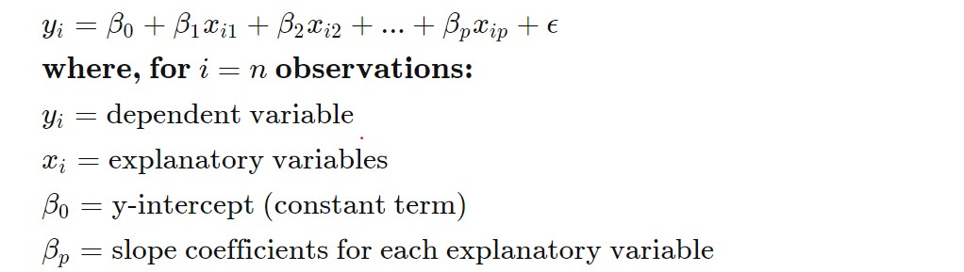
Linear regression for multiple variables

Slide 4
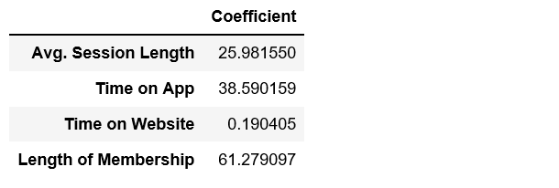
Y is the target - amount spend in an year , X as multiple features we have used and Beta 0 ,1 etc. are the coefficient which provides the final target , once you plug the rest of the features .
Since the weight factor or the coefficient value is higher for Time on APP compare to Time on website and when we predict the target value or try to predict i.e how much a customer spent on any given year ,along with Length of membership, Time on App will have greater say and hence should be given priority .

